Slide 1


Ecological Niche Modeling Overview
University of Florida

Slide 2
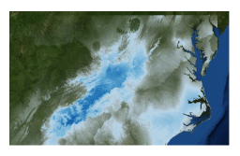
Ecological Niche Modeling
MaxEnt
uses the principle of maximum entropy on presence-only data to predicted the species’ potential geographic distribution (or niche)

Slide 3
MaxEnt
MaxEnt used only presence and pseudo-absences for model development
No ”best” algorithm for modeling (Qiao et al. 2015, Methods Ecol Evol), but MaxEnt generally performs well across evaluation criteria (Aguirre-Gutierrez et al. 2013, PLoS One)
What does it do?
Makes predictions about the probability that conditions are suitable for a given taxa to occur (does not calculate probability of occurrence!)
Models should be chosen that are as similar as possible to prior expectations while also being consistent with the data.
Important notes:
The grids must all have the same geographic bounds and cell size (i.e. all the ascii file headings must match each other perfectly)

Slide 4
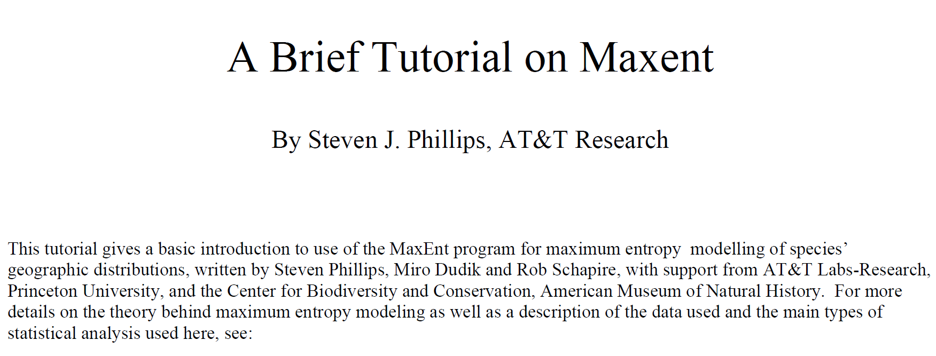
https://biodiversityinformatics.amnh.org/open_source/maxent/Maxent_tutorial2017.pdf

Slide 5
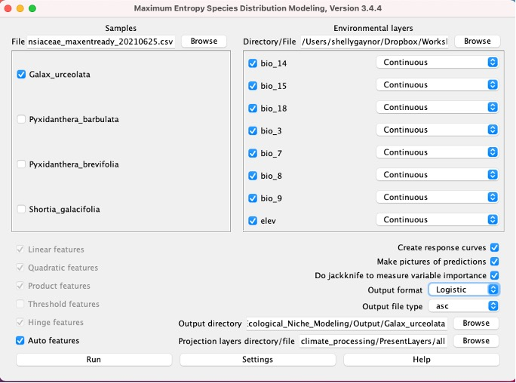
Only one species at a time
Select species specific training layers
Select output directory
Select projection layers

Slide 6
Select logistic

Slide 7
Select logistic
Logistic calculates the conditional probability of occurrence. The probability will be between 0 - 1.

Slide 9
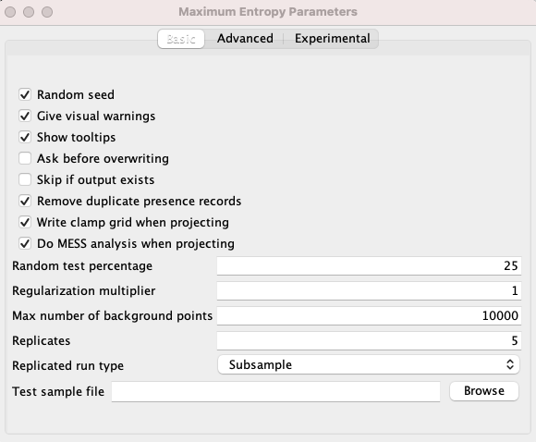
Subsample: in which the presence points are repeatedly split into random training and testing subsets.
Notes:
Replication!

Slide 10
Random test percentage: “randomly set aside 25% of the sample records for testing”
Used to calculate the threshold to make a binary prediction, with suitable conditions predicted above the threshold and unsuitable below!
Regularization multiplier: affects how focused or closely-fitted the output distribution is. Values under 1.0 (low values) may result into overfitting while values over 1.0 (high values) tend to yield less localized prediction
Notes:
The “25” we entered for “random test percentage” told the program to randomly set aside 25% of the sample records for testing.
This is used to calculate the threshold to make a binary prediction, with suitable conditions predicted above the threshold and unsuitable below

Slide 11
Clamping treats variables outside the training range as if they were at the limit of the training range.
Clamp grid depicted are the absolute difference between predictions with and without clamping.
Random seed: different random test points each time the it runs
Notes:
Replication!

Slide 12
MESS = Multivariate Environmental Surface Similarity (MESS)
Notes:
Replication!

Slide 13
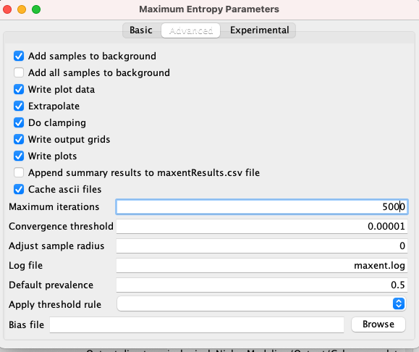
Extrapolate = extent to estimate
Iterations = allows the model to have adequate time for convergence (coming together)

Slide 14
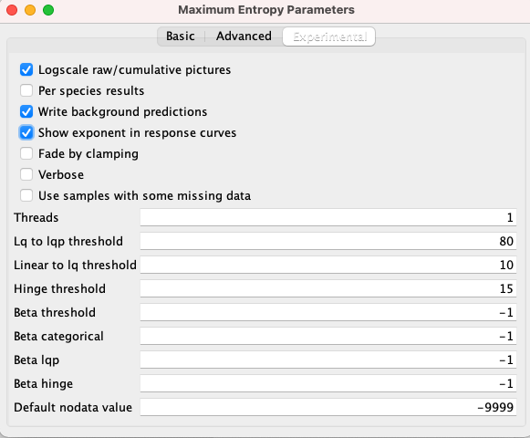

Slide 16
MaxEnt Demo
Files for this activity can be found in “Demo/Manual/Ecological_Niche_Modeling/”
Try out the demo!
R-based ENM
Cross-validation and data partitioning
Advance model comparisons
Evaluating ENMs

